Slide 1
Reconstructing dynamics from snapshots
Carmeline Dsilva , Bomyi Lim, and Stanislav Shvartsman
IDeAS seminar
15 October 2014

Slide 2
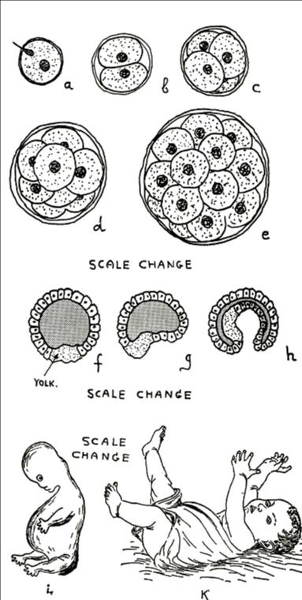
From a single cell to an organism
Embryogenesis reflects a genetic program
We are interested characterizing developmental trajectories
What does that mean?
Multivariable spatiotemporal patterns
What do we need to monitor?
From “One, two, three, infinity” by Gamow

Slide 3
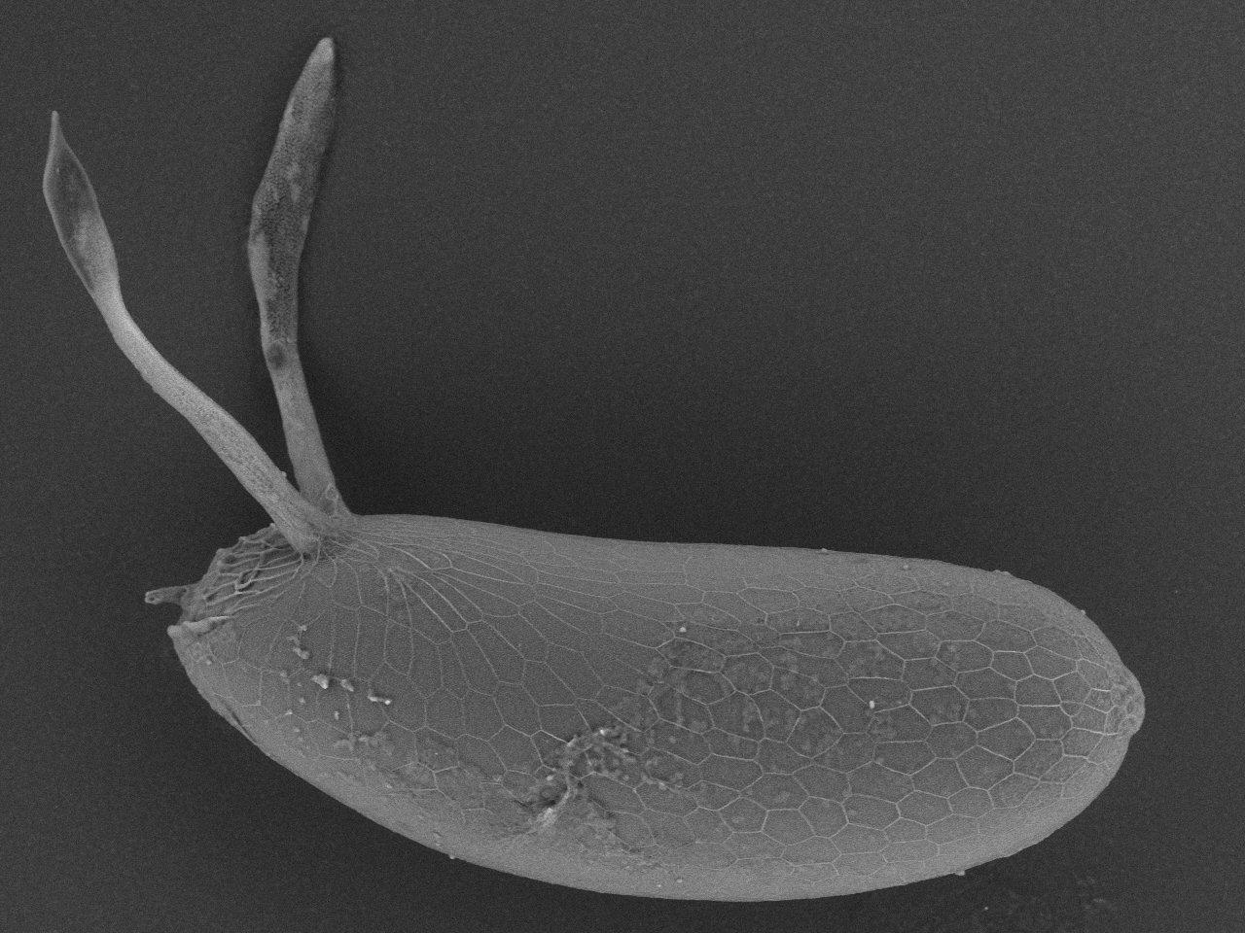
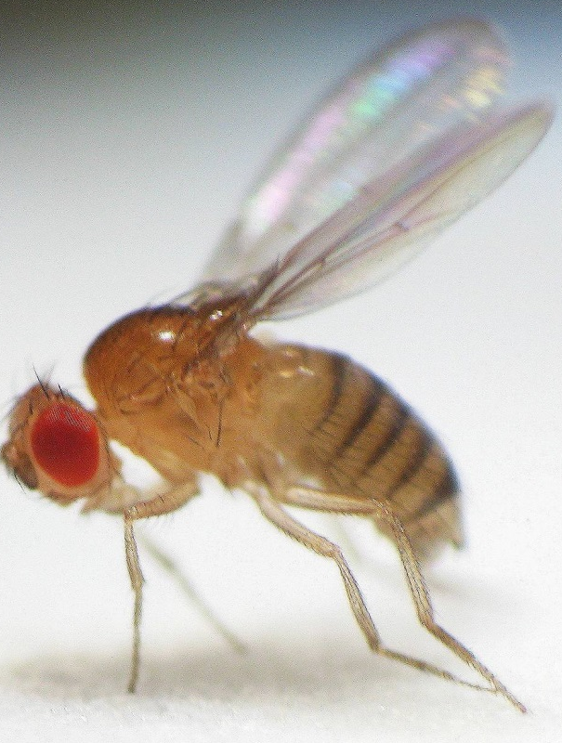
Core processes
are conserved
across species
D
A
A
P
P
V

Slide 4
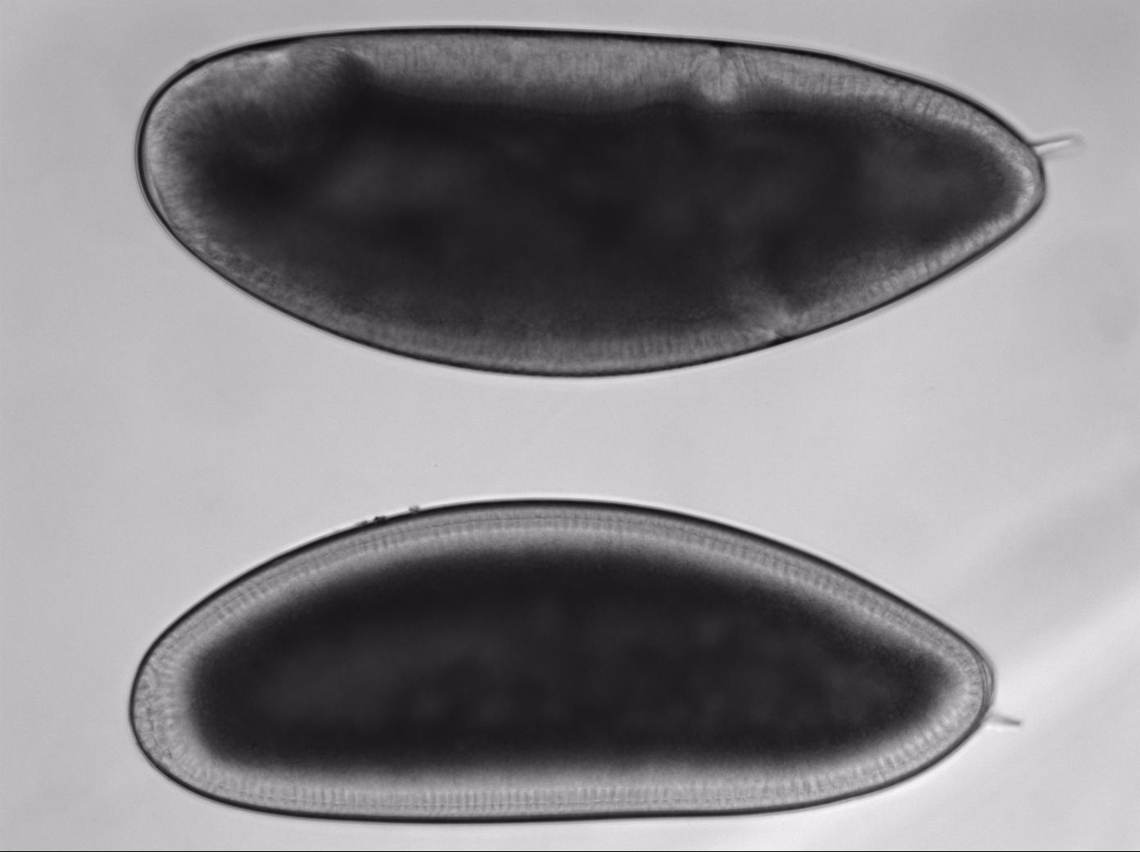

Slide 5
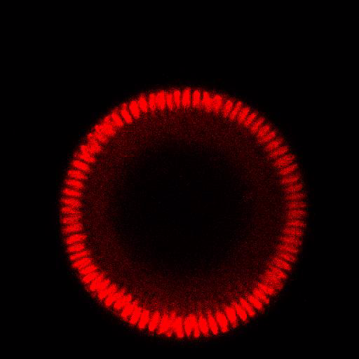
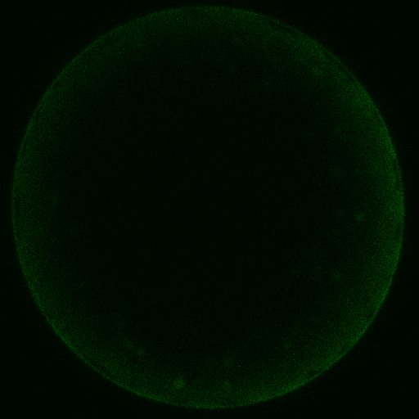
Changes in morphology and changes in distribution of chemical factors
A small number of variables can be tracked in real time

Slide 6
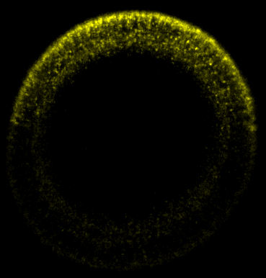
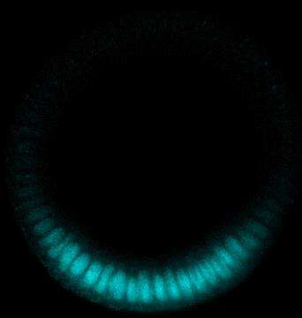
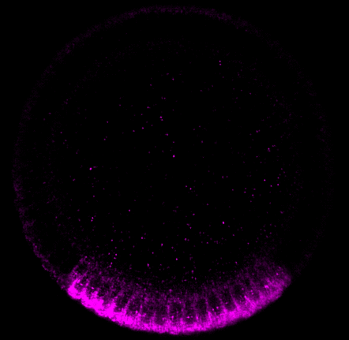
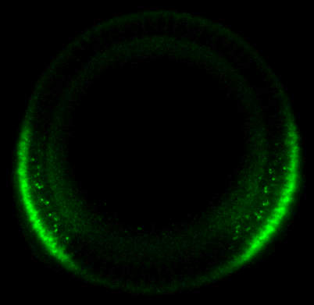
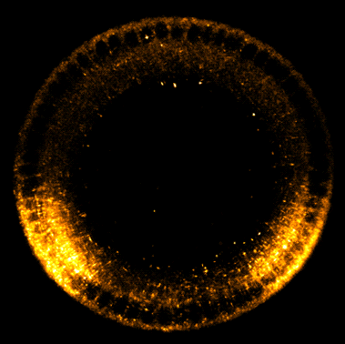
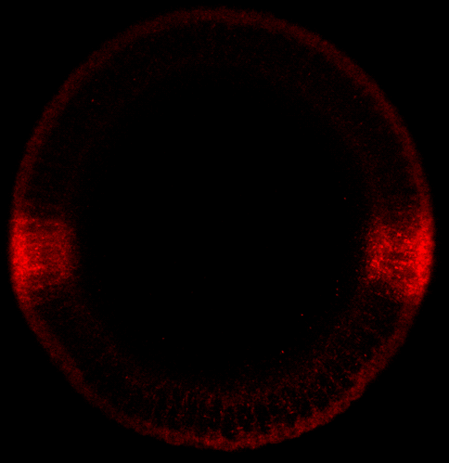
At the same time, the system is patterned
A
B
C
D
E
F
G
Dozens of species, in different patterns

Slide 7
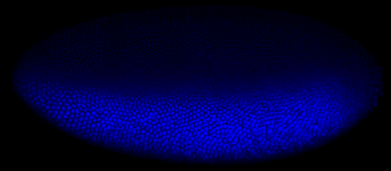
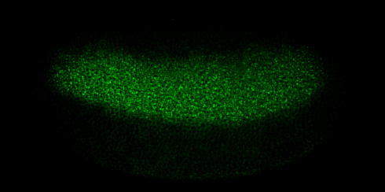
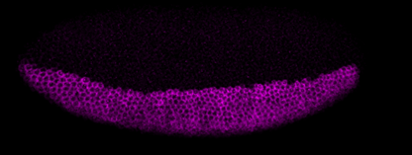
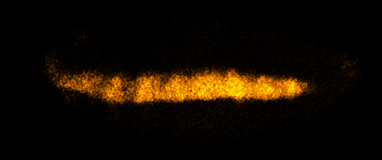
Zld
Dl
dpp
sog
Twi
sna
rho
ind

Slide 8
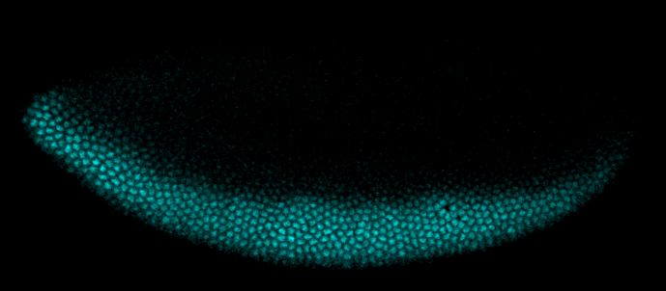
Protein localization
Immunostaining
Secondary antibody
with fluorochrome
Twi
Primary antibody
Target protein

Slide 9
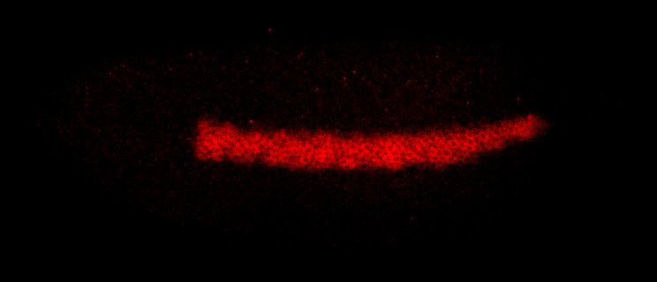
Gene expression patterns
Fluorescent In situ hybridization (FISH)
Secondary antibody
with fluorochrome
Primary antibody
ind
DIG-labeled probe
Target mRNA

Slide 10
Microfluidics for imaging
Chung, Kim, et al. Nature Methods, 2011

Slide 11
Data types at this point
A small number (for now) of movies for a small number of properties
A large number of snapshots, each of which comes from a different embryo and reveals 1-3 different variables
One experiment produces 50-100 such snapshots
Dozens of experiments, more on the way

Slide 12
What do we want?
Reconstruct developmental trajectories
Estimate their variability
Explain and model observed dynamics
What was done so far?
Registration and ordering of snapshots
Quantitative estimation of developmental age
Merging of live and imaging data

Slide 13

Example Data
Live Movie
One channel, orientation and time is known
Fixed Images
Several channels, orientation and time is unknown

Slide 14
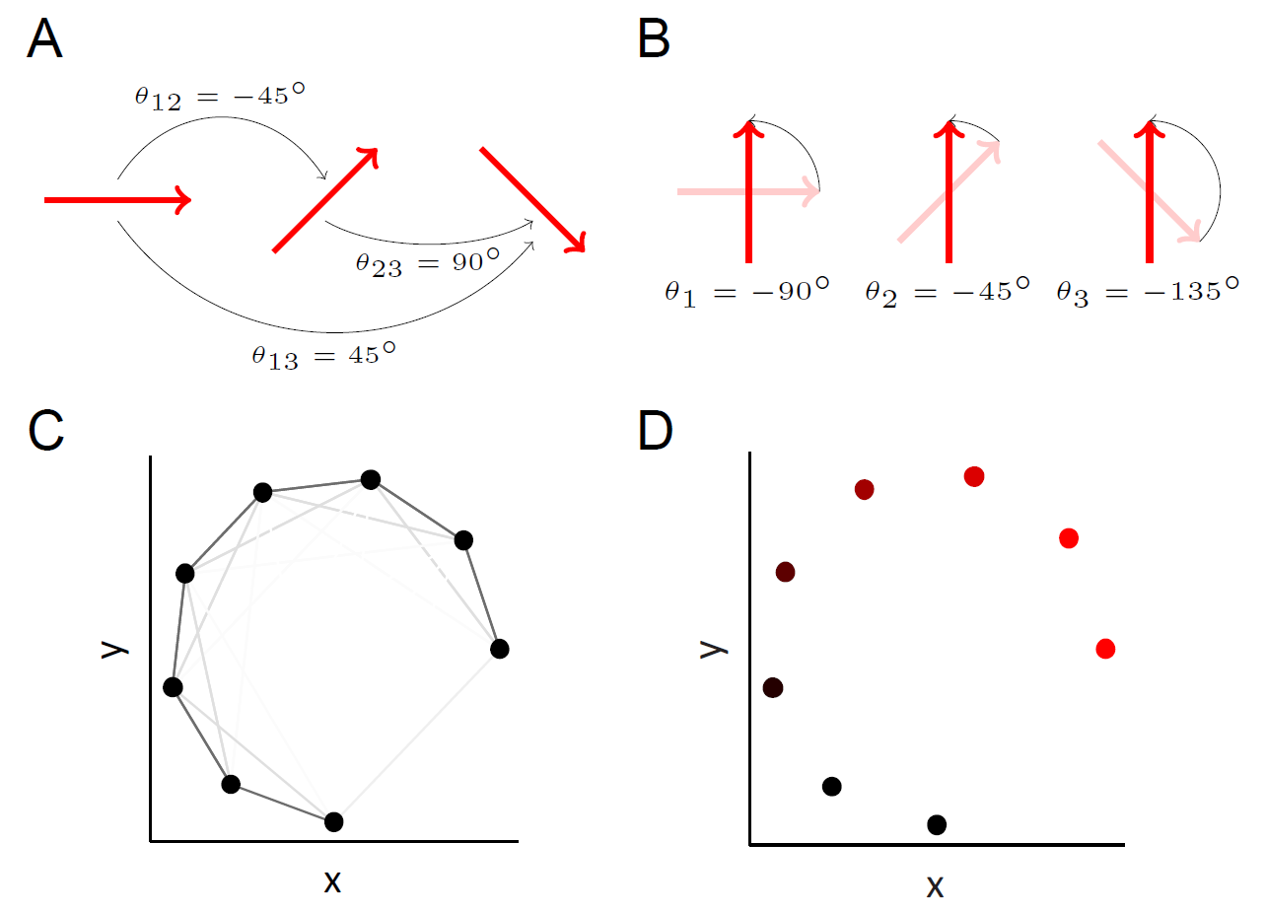
Registration and Temporal Ordering of Fixed Images
Both the rotational orientations and the relative times are unknown
We can register and order the images using vector diffusion maps
Vector diffusion maps will register similar images
The first VDM coordinate will parameterize developmental time/age of the images

Slide 15
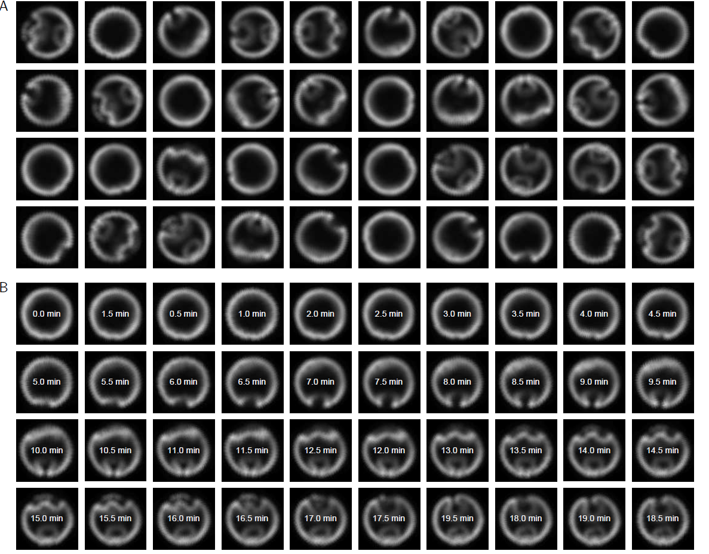
Validation of Methodology using Live Imaging
To validate using VDM as a method for registering and temporally ordering such images, we take a live movie of development, arbitrarily rotate each frame, and scramble the order of the frames
Frames from a single-channel movie, arbitrarily rotated and shuffled

Slide 16
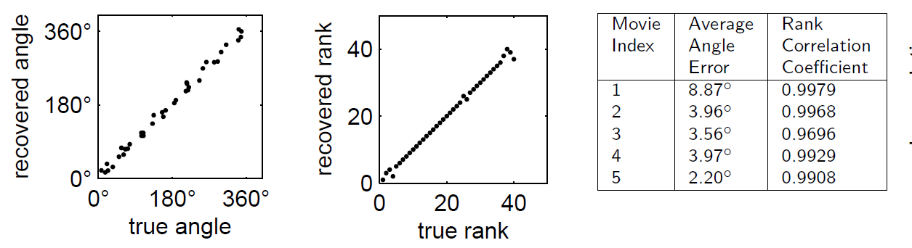
Validation of Methodology using Live Imaging
VDM can accurately and reproducibly recover the correct temporal order for relatively small data sets (<100 images)
Images, registered and ordered using VDM
The recovered angles and ranks using VDM are accurate across multiple live imaging data sets

Slide 17
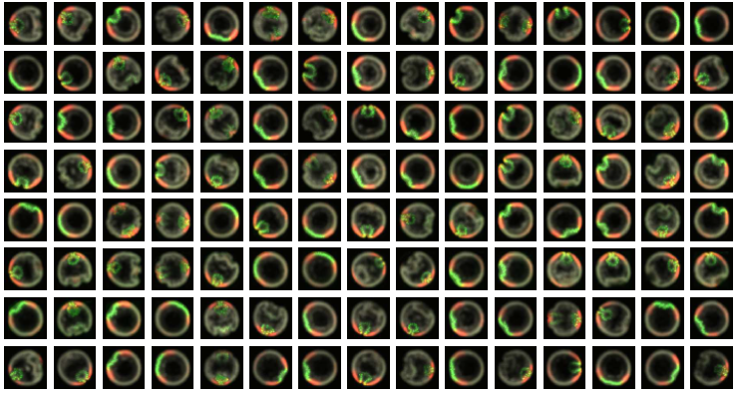
Ordering Fixed Images
We now use VDM to register and temporally order a data set of fixed images with several channels
Fixed images with three channels. Each image is from a different embryo at a different and unknown developmental time.

Slide 18
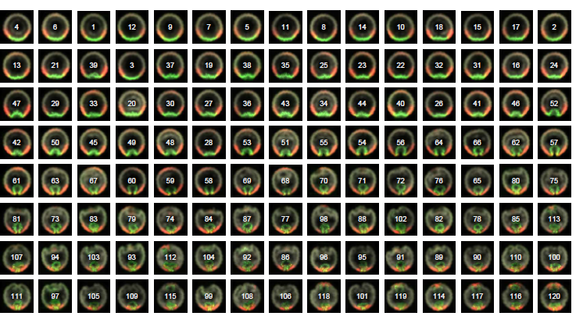
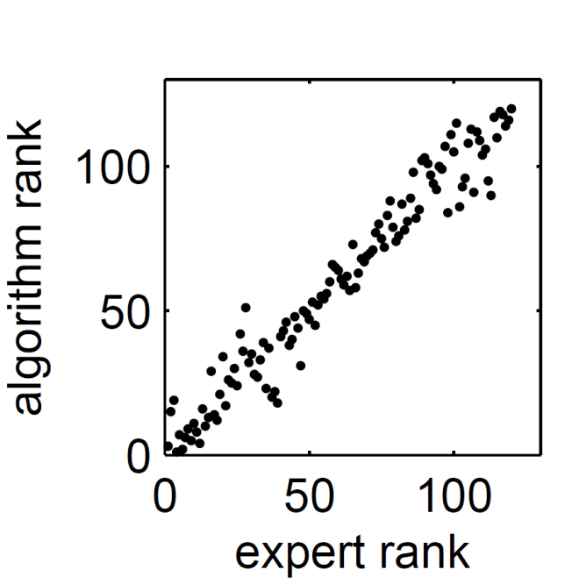
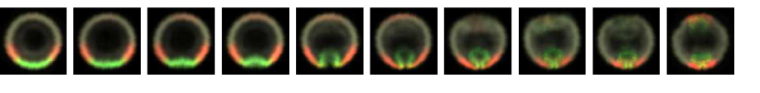
Ordering Fixed Images
The VDM ordering is consistent with the manual ordering from an embryologist
We can compute a moving average of the ordered images to obtain a “representative” developmental trajectory

Slide 19
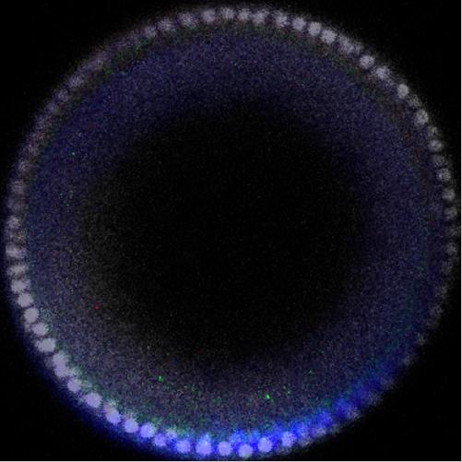
Merging Live Imaging with Fixed Images
For many applications (e.g., kinetics), we need real-time information, not only relative orders
We would like to merge the real-time single-channel live imaging data with the multiple-channel fixed data to obtain a real-time information for multiple channels.
Goal: estimate times of fixed images from live movie data
+
=

Slide 20
Principal Component Analysis to Reduce Image Dimension
Compute first five principal components from images collected from live imaging
Look at projection coefficients as a function of time

Slide 21
Linear Model to Predict Times of New Images
Fit linear regression model
time = β₀ + β₁PC₁+ β ₂PC₂ + β ₃PC₃ + β ₄PC₄ + β ₅PC₅
PC are the projection coefficients
Find β₀,…,β₅ using live imaging as training data
time =
β₀ + β₁PC₁+ β ₂PC₂
+ β ₃PC₃ + β ₄PC₄ + β ₅PC₅
= 12.37 min
Predict time (with error bars) using regression model
PC₁ =
-1191
PC₂ =
-843
PC₃ =
-272
PC₄ =
-693
PC₅ =
1000
New fixed image
Compute projection coefficients onto PCA modes

Slide 22
Interpolating Signals
1. Select frame from movie
(60 minutes)
4. Compute average over fixed images
(cross-dissolve)
2. Find fixed images which have similar times
5. Combine average fixed image with movie frame
3. Extract channels from fixed images

Slide 23
Multichannel Movie
Gray nuclei are from a live imaging study of a single embryo,
colored signals are from multiple fixed embryos

Slide 24
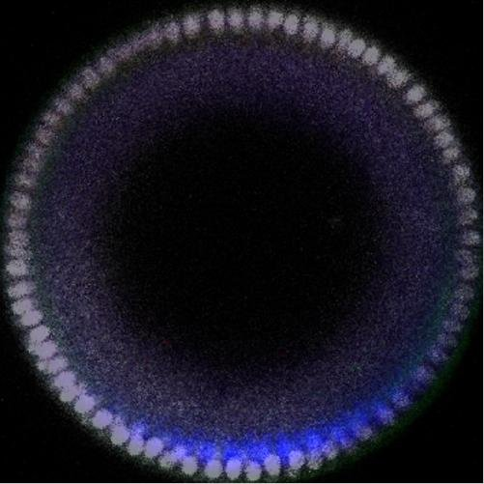
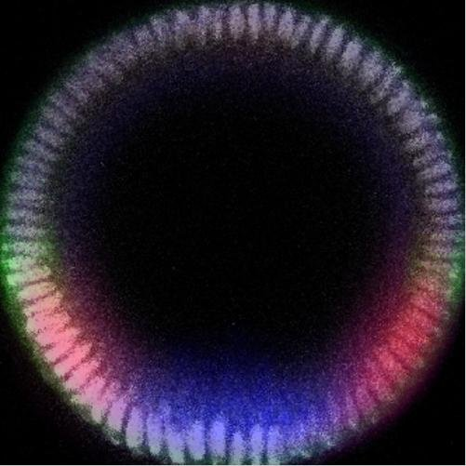
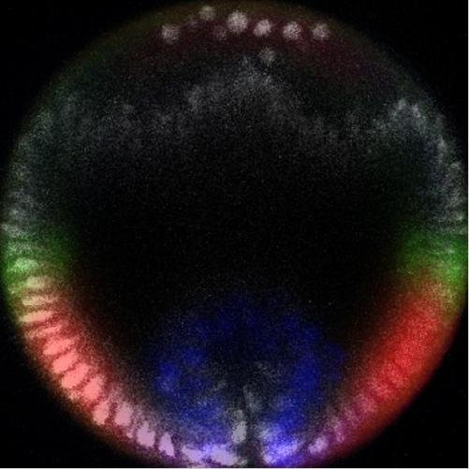
Errors in Merging Data
Signal is not localized to nuclei
This is (biologically) incorrect
Current work: local warping of images so that nuclear signals overlap

Slide 25
Future Work
Image morphing
Nonlinear time estimation
Statistics/variability in development
What are the important statistics to look at?
Want to propose model with well-defined errors/standard deviations
Lateral images
Differences from developmental times + viewing direction

